Slide 1

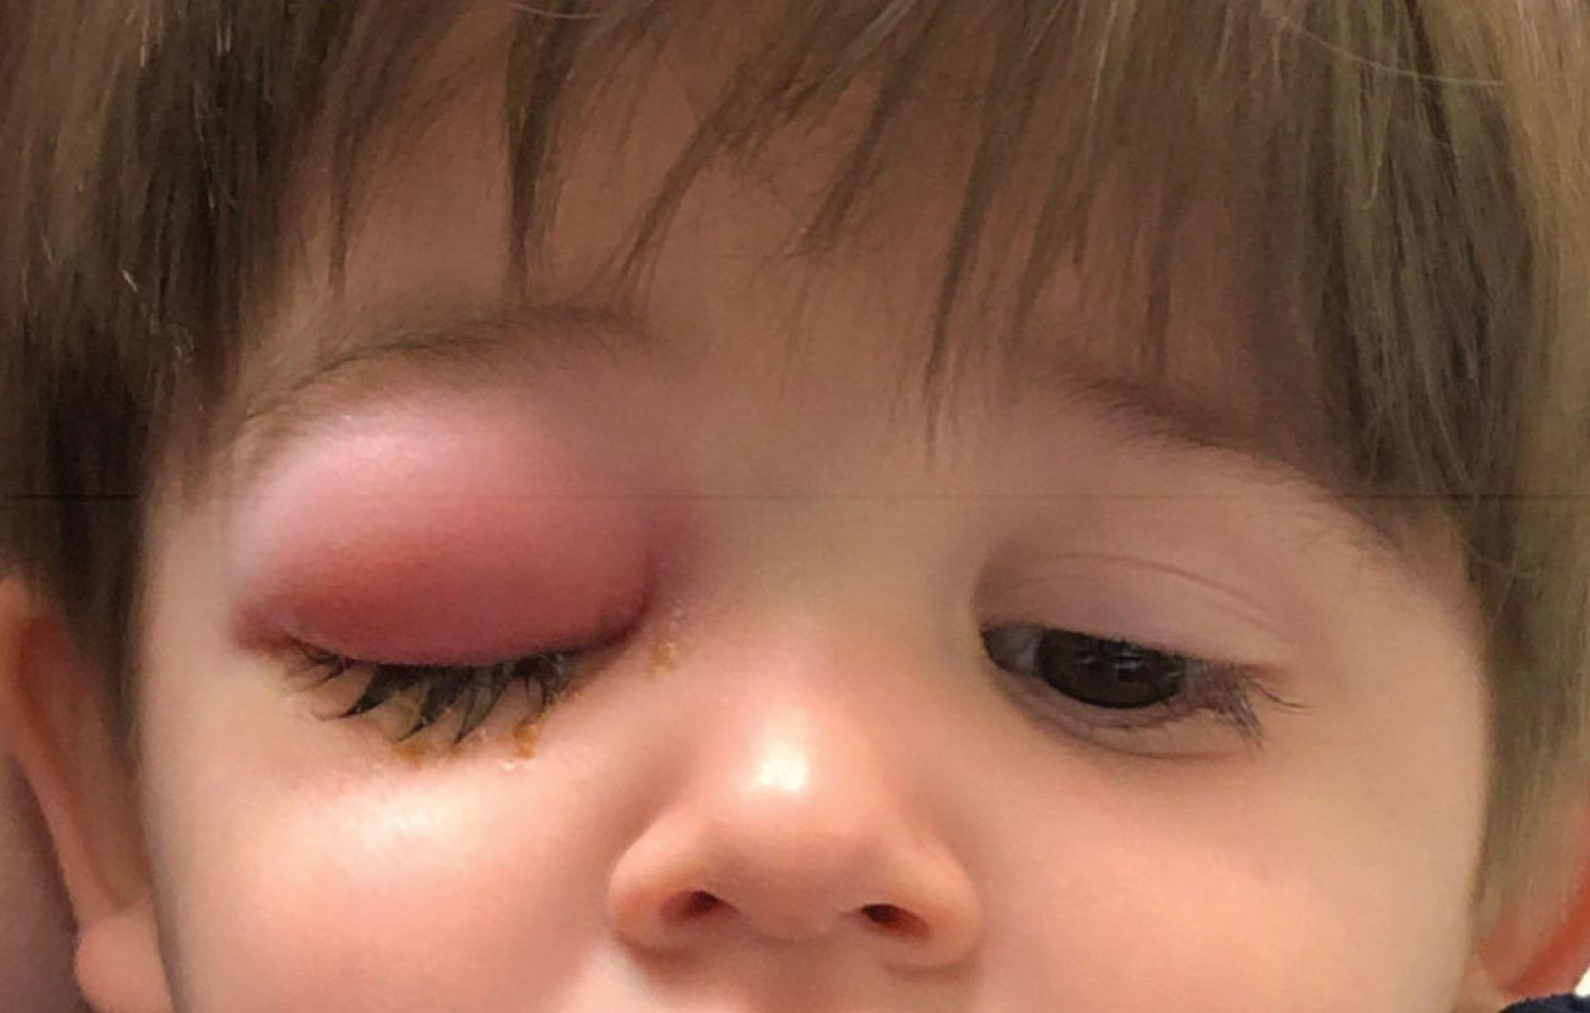
Preseptal Cellulitis

Slide 2
Index
Definition
Etiology
Mode of Infection
Clinical Features
Treatment
Reference

Slide 3
Definition
Preseptal Cellulitis refers to the infection of the subcutaneous tissue anterior to the orbital septum
It is included under orbital disease because the facial veins are valveless and preseptal cellulitis may spread posteriorly to produce Orbital Cellulitis.

Slide 4
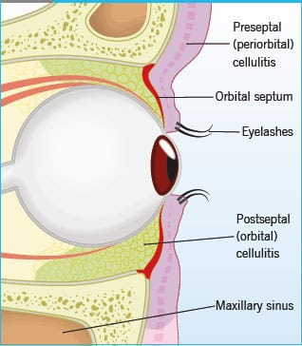

Slide 5
Etiology
Staph. aureus
Streptococcus pyogenes
H. influenzae ( occasionally )

Slide 6
Mode of Infection
Exogenous Infections
  Laceration,
  Insect Bites
  Eyelid Operation
Extension from Local Infections
  Acute Hordeolum
  Acute Dacryocystitis
Endogenous Infections
  Hematogenous spread from
    Middle ear
    Upper Respiratory Tract

Slide 7
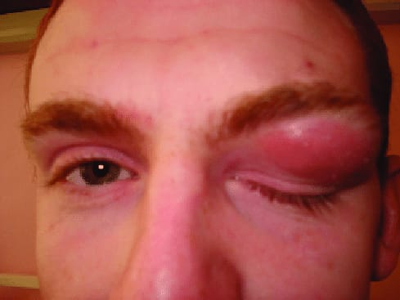
Clinical Features
Painful acute periorbital swelling
Erythema and hyperemia of lids
Fever and leukocytosis
Proptosis is absent
Visual Acuity is Normal
Ocular Movement - Normal
Conjunctiva usually not congested

Slide 8
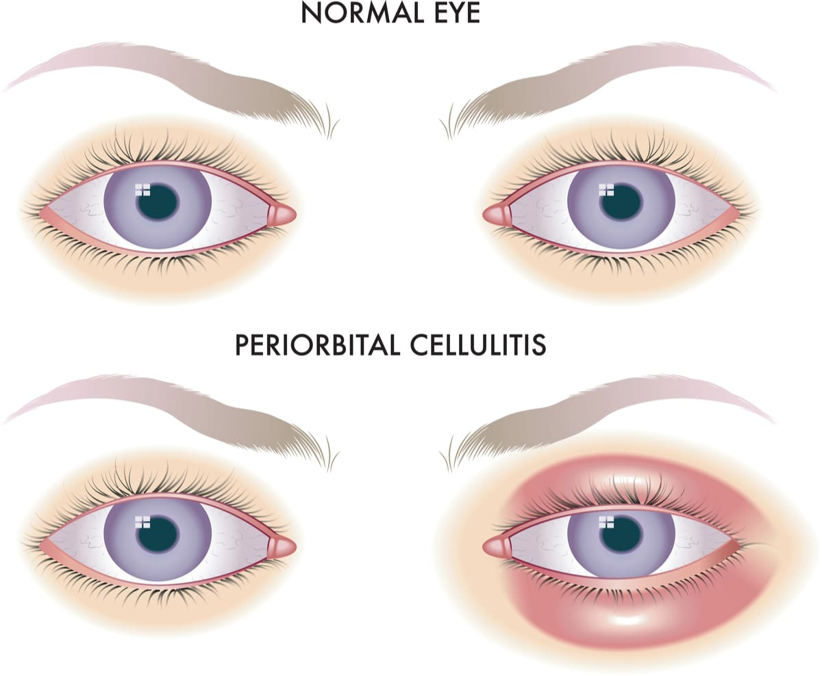
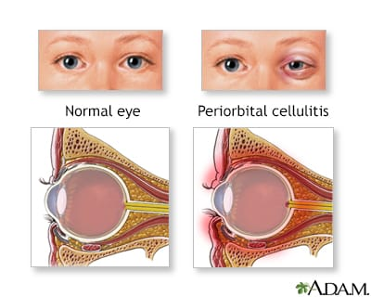
Preseptal Cellulitis Diagrammatic Representation

Slide 9
Treatment
Systemic Antibiotics
  Mild to Moderate Cases
    Co-amoxiclav 500/125 mg TDS or flucloxacillin 500mg QID x10 days
  Severe Cases
    Hospitalisation for IV route
      Ceftriaxone 1-2 g/day in divided dose x 4-5 days —----> Treat as Mild Case
Systemic Analgesics
  To reduce pain and inflammation

Slide 10
Treatment (contd.)
Warm Compresses
  2-3 times a day
  Have soothing effect
Surgical Exploration
  In the presence of
    Fluctuant mass
    Abscess
    Foreign Body suspected

Slide 11
References
Text of Ophthalmology, A K Khurana
Parsons’ Disease of the Eye 24th ed

Slide 12

Thank you

